Slide 1
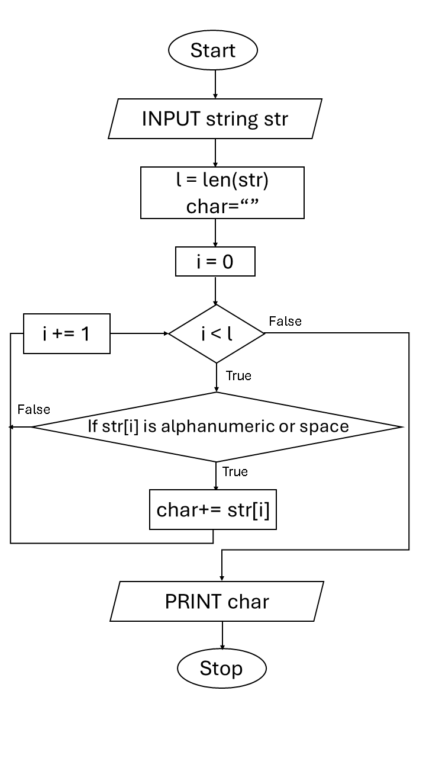
Experiment 10
10.1.1 Remove Punctuations from a
String
Algorithm :
Step 1 : Start Step 2 : Input string str Step 3 : Set char as an empty string Step 4 : Find length of string and store in l Step 5 : Set i = 0 Step 6 : Repeat steps while i is less than l Step 7 : Check if the character is a letter or digit or a space Step 8 : If yes, add the character to char Step 9 : Increase i by 1 Step 10 : Go back to Step 6 Step 11 : Print char Step 12 : Stop
Flowchart :

Slide 2
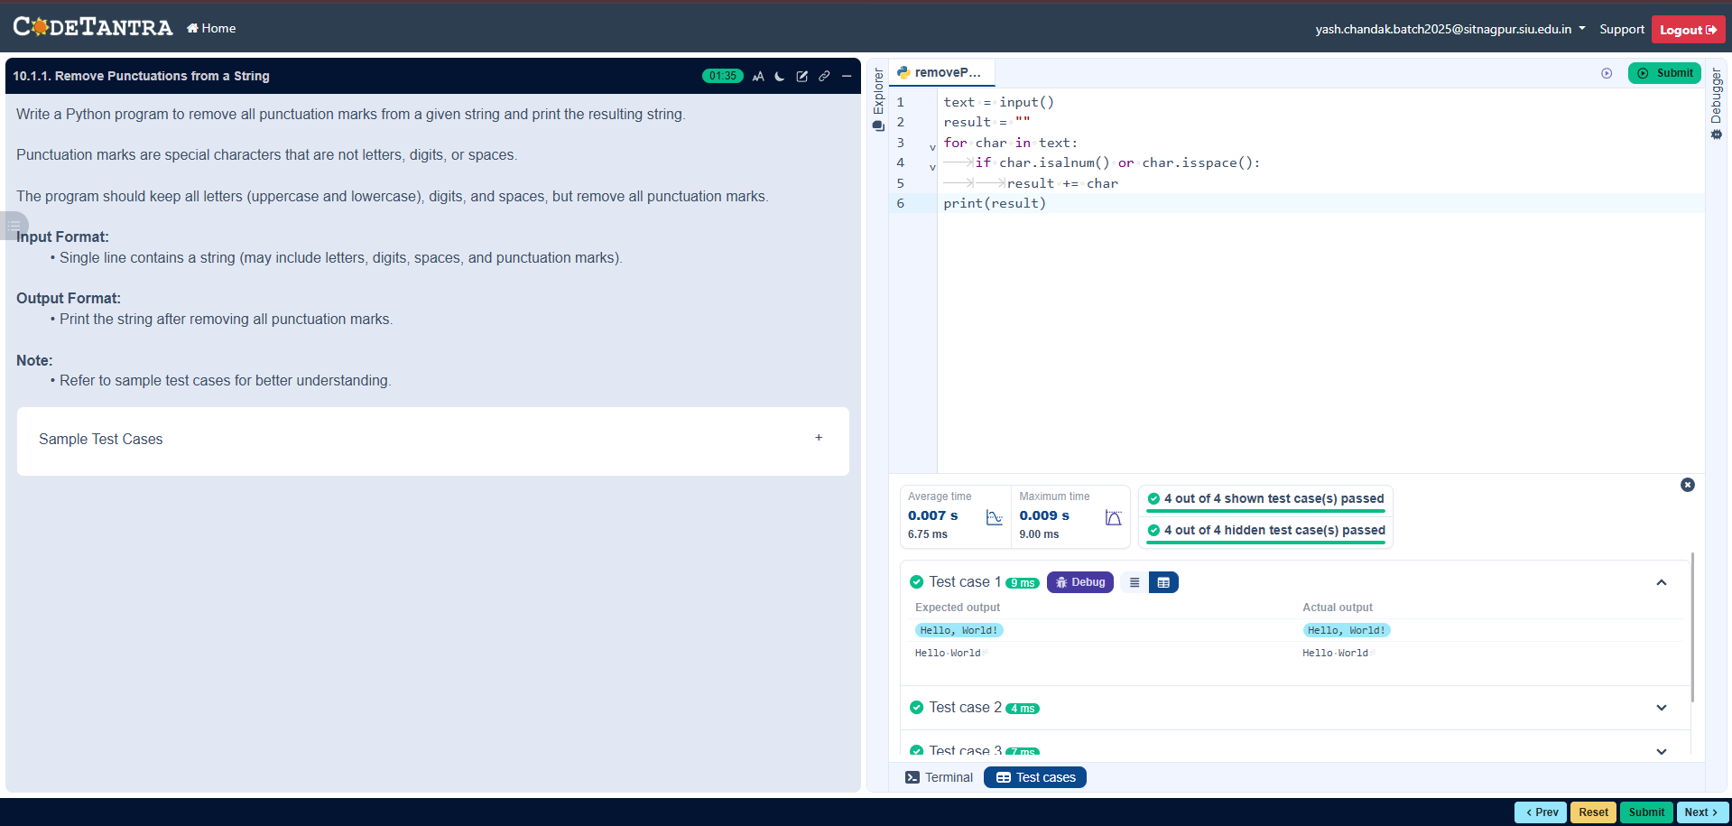
Code :
str=input()
char = "“
l=len(str)
for i in range(0,l):
if str[i].isalnum() or str[i].isspace(): char+=str[i]
print(char)
Execution :

